Slide 1
SLIDING WINDOW PROTOCOL
Name – Chayan Mukherjee Stream – CSE Year – 3rd Semester – 6th
Roll No. – 16800117050 Subject – Computer Network Assignment

Slide 2
CONTENT:
Communication
Sliding Window Protocol
Key Concept
Piggy Backing
Derivation
Implementations of sliding window protocol
Merits and Demerits

Slide 3
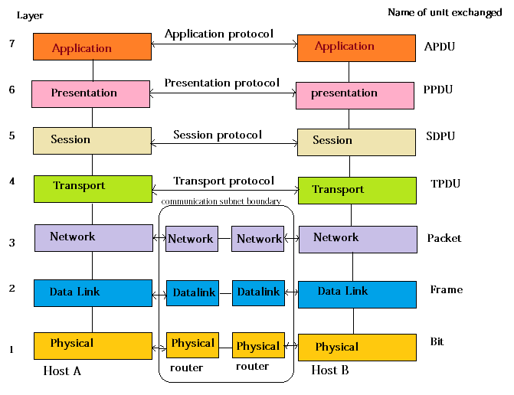
COMMUNICATION:
7 Layer OSI Model:
Here host A transmits data and host B receives the data.

Slide 4
SLIDING WINDOW PROTOCOL:
Sliding window protocol is a flow control protocol.
It allows the sender to send multiple frames before needing the acknowledgements.
Sender slides its window on receiving the acknowledgements for the sent frames.
This allows the sender to send more frames.
It is called so because it involves sliding of sender’s window.
Maximum number of frames that sender can send without acknowledgement =
Sender window size

Slide 5
KEY CONCEPT:
Both the sender and receiver maintain a finite size buffer to hold outgoing and incoming packets from the other side.
Every packet sent by the sender, must be acknowledged by the receiver. The sender maintains a timer for every packet sent, and any packet unacknowledged in a certain time is resent.
The sender may send a whole window of packets before receiving an acknowledgement for the first packet in window. This result in higher transfer rates, as the sender may send multiple packets without waiting for each packet’s acknowledgement.
The Receiver advertises a window size that tells the sender how muck data it can receive, in order for the sender not to fill up the receivers buffers.
Efficiency can also be improved by making use of the full-duplex line.
A
B

Slide 6
PIGGY BACKING:
When a data frame arrives, instead of immediately sending a separate control frame, the receiver restrains itself and waits until the network layer passes it to the next packet.
The acknowledgement is attached to the outgoing data frame. (using the ack field in the frame header)
The acknowledgement gets a free ride on the next outgoing data frame.
The technique of temporary delaying outgoing acknowledgements so they can be cooked on to the next outgoing data frame is piggybacking.

Slide 7
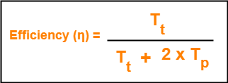
DERIVATION:
We know,
To get 100% efficiency, we must have-
η = 1
T_{t} / (T_{t} + 2T_{p}) = 1
T_{t} = T_{t} + 2T_{p}
Thus,
To get 100% efficiency, transmission time must be T_{t} + 2T_{p} instead of T_{t}.
This means sender must send the frames in waiting time too.
Now, let us find the maximum number of frames that can be sent in time T_{t} + 2T_{p}.
We have-
In time T_{t}, sender sends one frame.
Thus, In time T_{t} + 2T_{p}, sender can send (T_{t} + 2T_{p}) / T_{t} frames i.e. 1+2a frames.
Thus, to achieve 100% efficiency, window size of the sender must be 1+2a.

Slide 8
Required Sequence Numbers-
Each sending frame has to be given a unique sequence number.
Maximum number of frames that can be sent in a window = 1+2a.
So, minimum number of sequence numbers required = 1+2a.
1. Receiver’s Ability-
Receiver’s ability to process the data bounds the sender window size.
If receiver can not process the data fast, sender has to slow down and not transmit the frames too fast.
2. Sequence Number Field-
Number of bits available in the sequence number field also bounds the sender window size.
If sequence number field contains n bits, then 2n sequence numbers are possible.
Thus, maximum number of frames that can be sent in one window = 2n.
For n bits in sequence number field, Sender Window Size = min (1+2a , 2^{n})

Slide 9
IMPLEMENTATIONS OF SLIDING WINDOW PROTOCOL:
The two well known implementations of sliding window protocol are-
IMPLEMENTATIONS OF SLIDING WINDOW PROTOCOL
Go Back N Protocol
Selective Repeat Protocol

Slide 10
MERITS AND DEMERITS:
Merits
• Multiple packets can be transmit without waiting for acknowledgements.(not like stop & wait) Piggybacking (using full-duplex lines)
Demerits
• No limit of the size or sequence numbers that can be required in this protocol.
• The bandwidth may be wasted in some special situations.

Slide 11
Thank You
Name – Chayan Mukherjee Stream – CSE Year – 3rd Semester – 6th
Roll No. – 16800117050 Subject – Computer Network Assignment

